Slide 1
Discrete & Continuous Distributions (2)
Prof.N.L.Bhanu Murthy

Slide 2
Continuous Probability Distributions
A random variable is continuous if it can assume any value in some interval of real numbers.
Def: Let X be a continuous random variable. A function f such that
1. f(x) ≥ 0 for real x
2.
3.
is called probability density function.

Slide 3
Normal Distribution
A random variable X with probability density function
is said to have normal distribution with parameters µ and sigma.

Slide 4
Normal Distributions
This is a bell shaped curve with different centers and spreads depending on μ and σ
Note constants:
π=3.14159
e=2.71828

Slide 5
Normal Distributions
Normal distribution is defined by its mean and standard deviation!!
E(X)=μ =
Var(X)=σ² =
Standard Deviation(X)=σ

Slide 6
Normal Distributions

Slide 7
Normal Distributions
**The beauty of the normal curve:
No matter what μ and σ are,
the area between μ-σ and μ+σ is about 68%;
the area between μ-2σ and μ+2σ is about 95%; and
the area between μ-3σ and μ+3σ is about 99.7%.
Almost all values fall within 3 standard deviations.

Slide 8
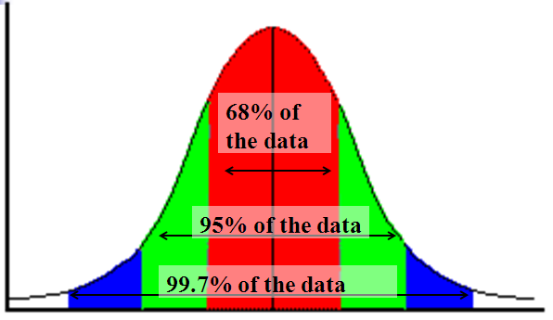
Normal Distributions
68-95-99.7 Rule

Slide 9
Normal Distributions
68-95-99.7 Rule in Math terms…

Slide 10
Normal Distributions

Slide 11
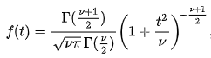
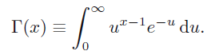
t Distribution
A random variable T with probability density function
is said to have a t distribution with v degrees of freedom and (gamma) is the Gamma function defined by

Slide 12
t Distribution
Standard Normal
(t with df = ∞)
t (df = 13)
t-distributions are bell-shaped and symmetric, but have ‘fatter’ tails than the normal
t (df = 5)
t

Slide 13
t Distribution
Upper Tail Area
Let: n = 3 df = n - 1 = 2 α = .10 α/2 =.05
df
.25
.10
.05
1
1.000
3.078
6.314
2
0.817
1.886
2.920
3
0.765
1.638
2.353
α/2 = .05
The body of the table contains t values, not probabilities
0
2.920
t

Slide 14
t Distribution
5%

Slide 15
t Distribution
0.002724

Slide 16
Continuous Probability Distributions

Slide 17
Thank You!

